Slide 1
LIBRARY MANAGEMENT SYSTEM
Team Members :
Presented By:
Swetha Kuchana
Ponna Akshaya
Nisha Varma
Rachana Potlabathini
Prathyusha Reddy
Pooja
Revathi Parwani

Slide 2

Introduction
Brain of any institute
LMS is a small program to manage library
- Adding new users, books and magazines/ newspaper
- Updating users, books and magazines/newspaper
- Removing users, books and magazines/newspaper.
- Issuing books and collecting books back.
- Searching for books.
Keep track of all information.
Easy to use
Information will be stored in database.

Slide 3

Objectives
Better and efficient service
Receive input and generate automatically output
Monitoring system
Reducing mistakes
Preserve details of the various books issued
Keep a track on their returns
Details will be available in a single click

Slide 4
Assumptions and dependencies
Dependencies
- Microsoft SQL server 2022 to store the database
- Eclipse IDE to develop the product
Assumptions
-System will be user friendly
-System will be active for 24 hours a day
-User will search the book by its name, author name, and date of publication
-System will complete on time
-User may access for any computer that has internet browsing capabilities and an internet
connection

Slide 5
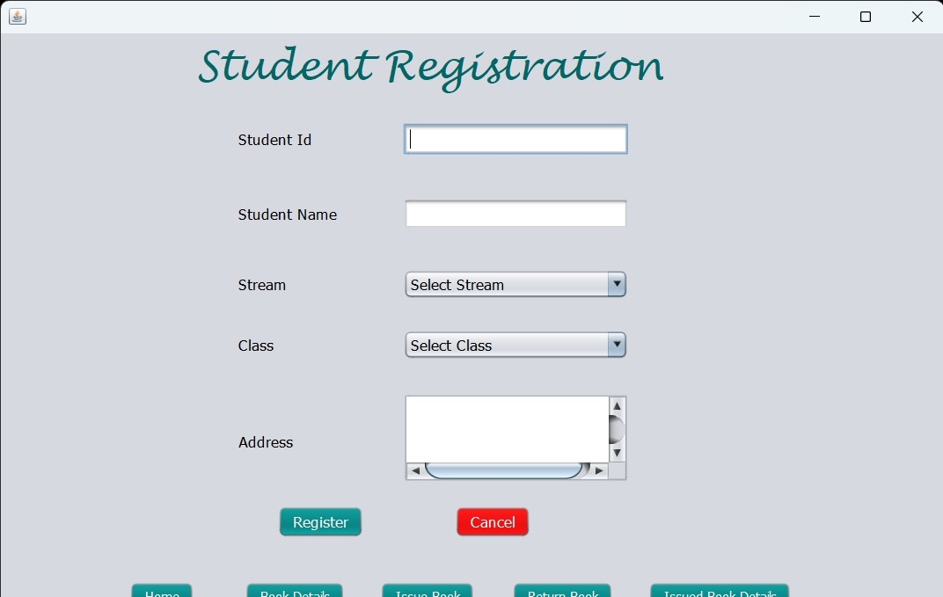
System Features
Add new user
-User request for registration.
-librarian add new user to system.
-Enter all valid details in registration form
- Generate a unique id for that user
-This feature of the system is of high priority
Functional requirements
-A new user which is not registered in the system
-Registration must be available
-Details must be correct

Slide 6
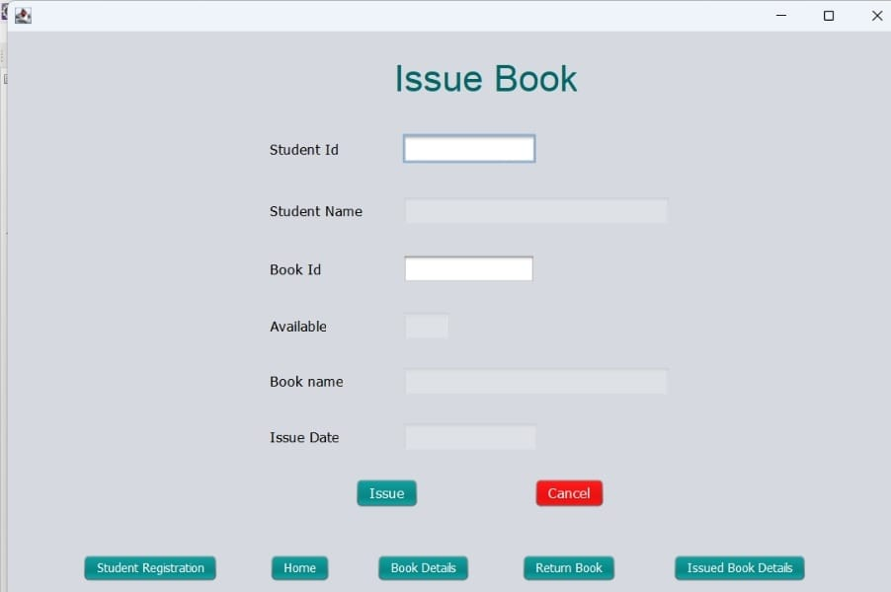
System features
Issue book
-Request for issuing a specific book.
-Student book limit is available than book will be issued.
-Limit exceed than book is not issued.
-This feature of the system is of high priority
Functional requirements
-Member must be registered against unique id.
-Books must be available.
-We must have librarian account which manages the whole system.

Slide 7
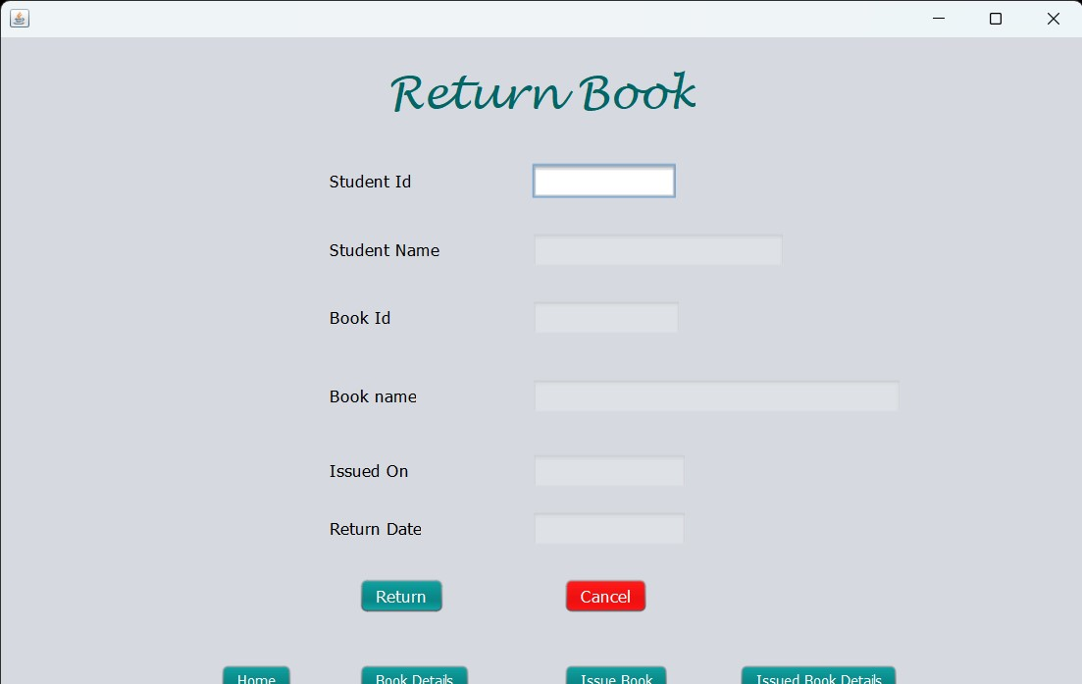
System features
Return Books
-Request for returning books
-Get member id and check return date
-Return Book
-Date exceed
-charge fine against member id
Functional requirements
-Member and issued book must have unique id
-Issued books must be available

Slide 8
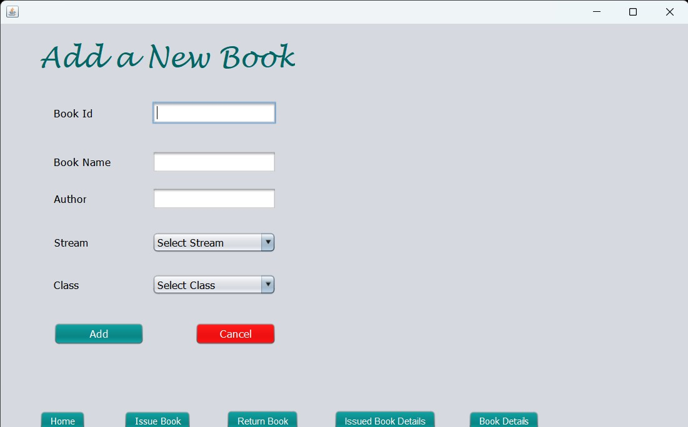
System features
Add new book category
-New book category available
-Book is of existing category librarian add it to existing librarian
-Book is of new category librarian add it to new librarian
-This feature is of medium priority
Functional requirements
-New book category must be available.

Slide 9
Non Functional Requirements
Performance requirements
-Performance should be fast and accurate
-System shall handle expected and unexpected errors
-Should be able to handle large amount of data
Safety requirements
-Must be two servers one main server and one backup server
Security requirements
-User authentication and validation of members using their unique member id
-User will see and manage all members account -CAPTCHA words will be used for user login.
-proper user authentication should be provided.

Slide 10
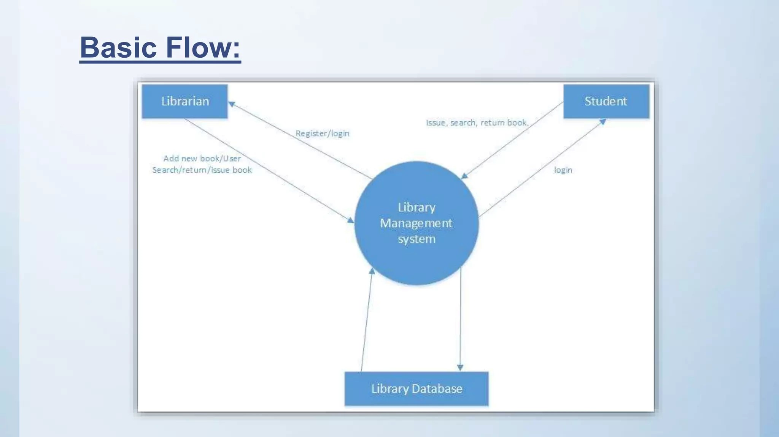
Analysis Models
Basic Flow

Slide 11
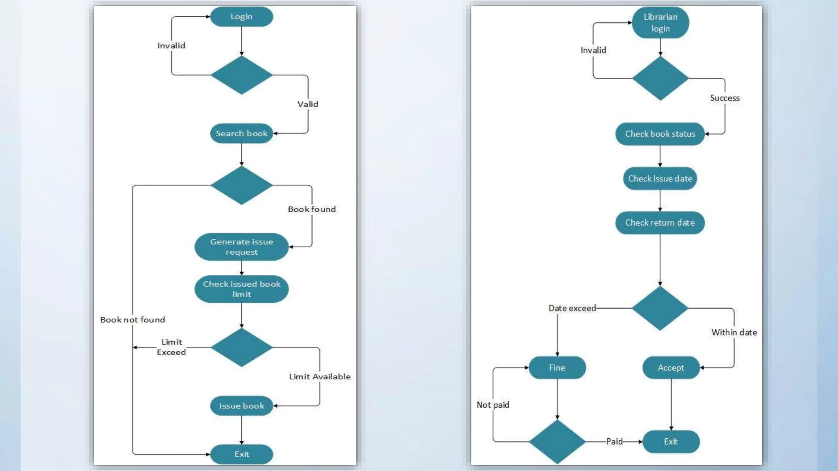
Issue and Return Book

Slide 12
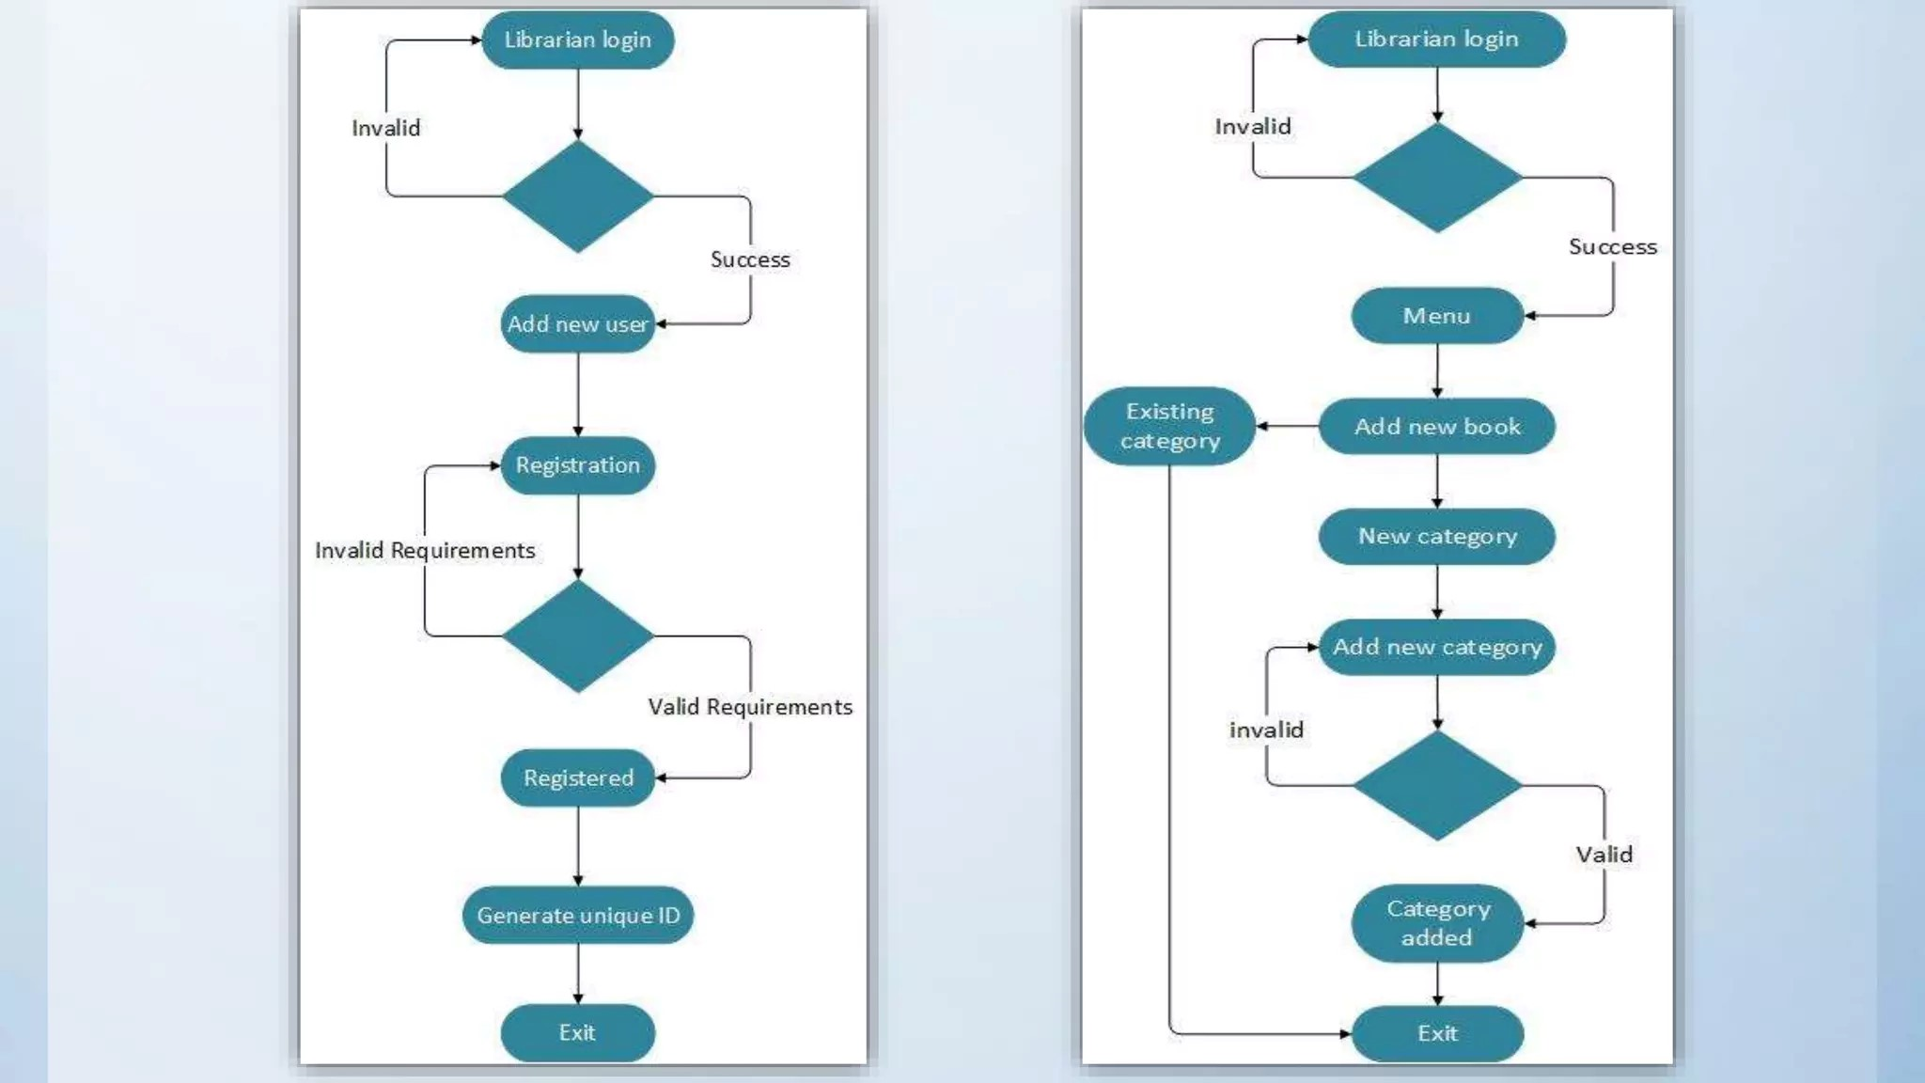
Add user & Book

Slide 13
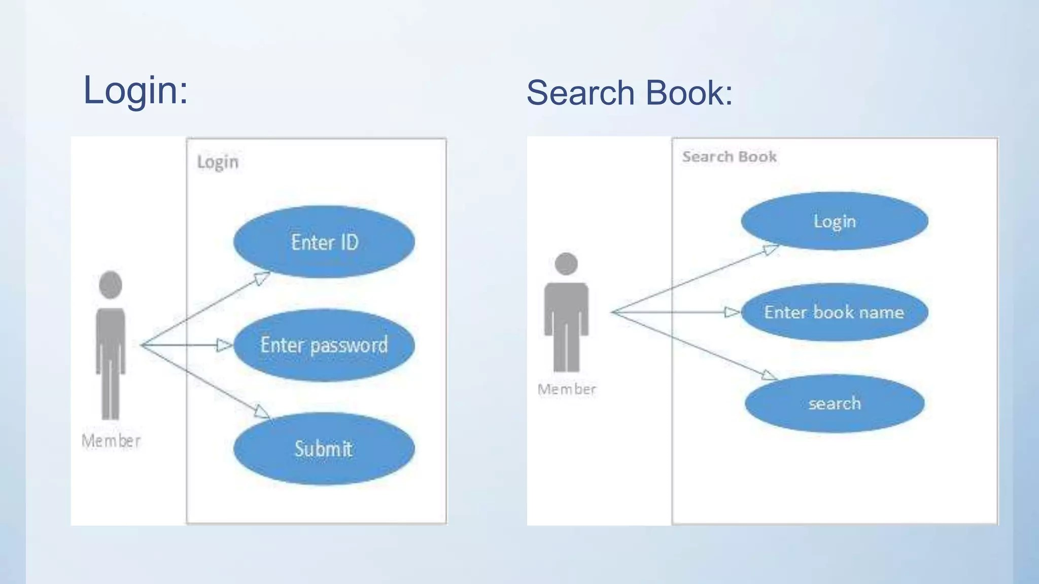
Use Classes

Slide 14
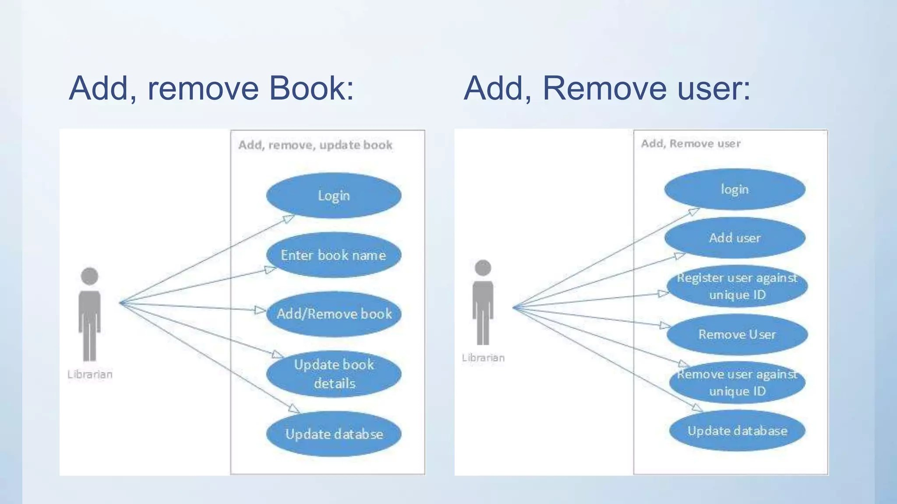
Remove Books and Remove User

Slide 15
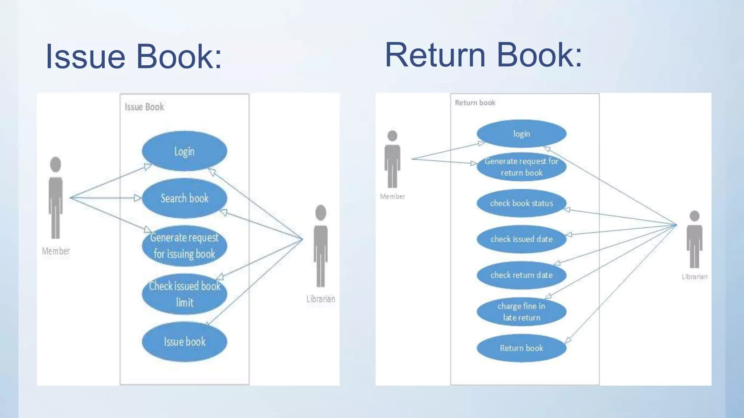
Issue and Return Books

Slide 16
THANK YOU

